Slide 1
Structured Query Language SQL
Notes:
The slides for this text are organized into chapters. This lecture covers Chapter 5.
This is one of the most important chapters in any discussion of database systems. Students must acquire a solid grasp of SQL. In particular, learning how to write queries in SQL is important, and comes only with practice.
The slides present the concepts through examples. The chapter contains several additional examples with in-depth explanations; assign these as additional readings. The exercises contain numerous further examples, and come with supporting online material. If you need additional time to cover this material, consider abbreviating the earlier discussion of algebra and calculus, and reinforcing the same concepts in the context of SQL.
Note that some new SQL:1999 features for the HAVING clause are covered in these slides. (This material is not covered in the 2nd edition.) Also, material on cursors and other programmatic aspects of SQL has been moved to Chapter 6, following the revisions in the 3rd edition.

Slide 2
Query Languages
Allows manipulation and retrieval of data from the database
Relational model supports simple, powerful query languages
  Strong formal foundation based on logic
2 formal query languages
  Relational Algebra (operational, can help in execution plan)
  Relational Calculus (non-operational)
  Structured Query Language SQL

Slide 3
Structured Query Language
1970
SQL consists of:
  DDL (Data Definition Language)
    Create conceptual schema
  DML (Data Manipulation Language)
    Relational operators
    Insert, Delete, Update
  VDL (View Definition Language)
    Specify user views & their mapping to the conceptual schema (in most DBMSs, done by DDL)
  SDL (Storage Definition Language)
    File organization
    Indexes

Slide 4
Contd..
A query is applied to relation instances, and the result of a query is also a relation instance
  Schemas of input relations for a query are fixed
  Schema for the result of a given query is also fixed

Slide 5
Case Study: Sailors Database
Sailors (sid:integer, sname:string,rating:integer,age:real)
Boats ( bid:integer,bname:string,color:string)
Reserves (sid:integer, bid:integer,day:date)

Slide 6
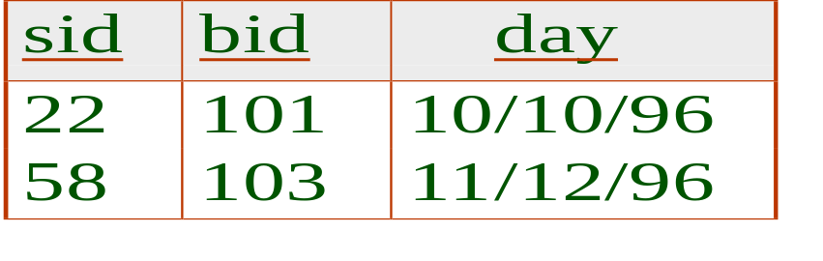
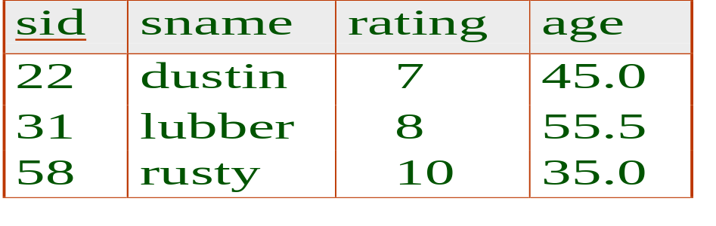
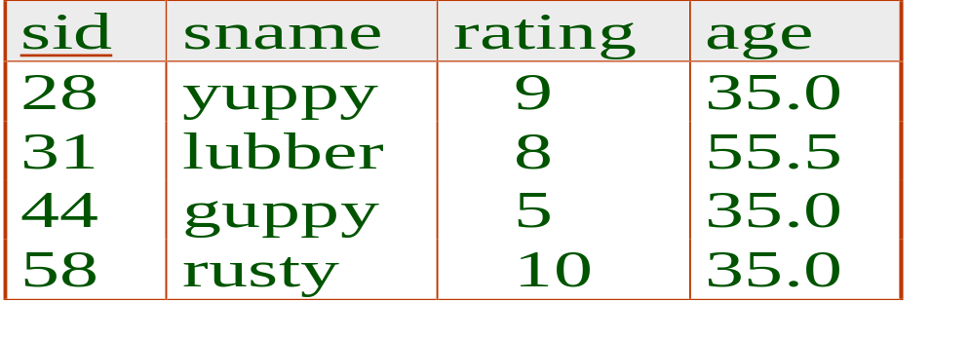
Example Instances
We will use these instances of the Sailors and Reserves relations in our examples.
If the key for the Reserves relation contained only the attributes sid and bid, how would the semantics differ?
R1
S1
S2

Slide 7
Basic SQL Query
SELECT [DISTINCT] target-list
FROM relation-list
WHERE qualification
relation-list A list of relation names (possibly with a range-variable after each name).
target-list A list of attributes of relations in relation-list
qualification Comparisons (Attr op const or Attr1 op Attr2, where op is one of(<,>,=) combined using AND, OR and NOT.
Boolean combination of conditions of the form expression op expression, op is comparison operator
Expression is a column name, a const, or arithmetic expression
DISTINCT is an optional keyword indicating that the answer should not contain duplicates. Default is that duplicates are not eliminated!

Slide 8
Conceptual Evaluation Strategy
Semantics of an SQL query defined in terms of the following conceptual evaluation strategy:
  Compute the cross-product of relation-list.
  Discard resulting tuples if they fail qualifications.
  Delete attributes that are not in target-list.
  If DISTINCT is specified, eliminate duplicate rows.

Slide 9
SQL : Basic Operations (1)
SELECT: Specifies columns to be retained in the result (deletes unwanted columns)
FROM: Specifies a cross product of tables (combines two relations)
WHERE: Specifies selection conditions on the tables mentioned in the FROM clause
Cross Product/Cartesian Product: R X S returns a relation instance whose schema contains all the fields of R ( in the same order as they appear in R) followed by all the fields of S ( in the same order as they appear in S).

Slide 10
Basic Operations (2)
Union: R UNION S
returns a relation instance containing all tuples that occur in either relation instance R or S
R and S must be UNION compatible and the schema is identical to R
UNION Compatible: the relations have same number of fields and the corresponding fields, taken in order from left to right, have the same domains

Slide 11
Basic Operations (3)
Intersection: R INTERSECT S
returns a relation instance containing all tuples that occur in both R and S.
The relation R and S must be union compatible.
Schema is same as R
Set-difference : R EXCEPT S
returns a relation instance containing all tuples that occur in R but not in S
R and S must be union compatible
The schema is same as R

Slide 12
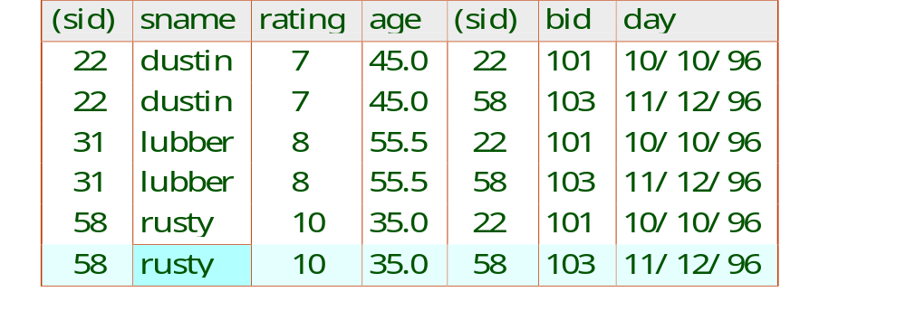
Example
SELECT S.sname
FROM Sailors S, Reserves R
WHERE S.sid=R.sid AND R.bid=103

Slide 13
SQL and RA
SELECT DISTINCT S.sname, S.age
FROM Sailors S
Contains just one pair of sailors with same (sname,age) pair.
Equivalent to ‘projection’ operation of RA
WHERE clause is used to to express RA ‘selection’

Slide 14
Find sailors who’ve reserved at least one boat
SELECT S.sid
FROM Sailors S, Reserves R
WHERE S.sid=R.sid
Would adding DISTINCT to this query make a difference?
What is the effect of replacing S.sid by S.sname in the SELECT clause? Would adding DISTINCT to this variant of the query make a difference?

Slide 15
Expressions and Strings
SELECT S.age, age1=S.age-5, 2*S.age AS age2
FROM Sailors S
WHERE S.sname LIKE ‘B_%B’
Illustrates use of arithmetic expressions and string pattern matching: Find triples (of ages of sailors and two fields defined by expressions) for sailors whose names begin and end with B and contain at least three characters.
AS and = are two ways to name fields in result.
LIKE is used for string matching. `_’ stands for any one character and `%’ stands for 0 or more arbitrary characters.

Slide 16
Find sid’s of sailors who’ve reserved a red or a green boat
SELECT S.sid
FROM Sailors S, Boats B, Reserves R
WHERE S.sid=R.sid AND R.bid=B.bid
AND (B.color=‘red’ OR B.color=‘green’)
UNION: Can be used to compute the union of any two union-compatible sets of tuples (which are themselves the result of SQL queries).

Slide 17
Contd..
SELECT S.sid
FROM Sailors S, Boats B, Reserves R
WHERE S.sid=R.sid AND R.bid=B.bid
AND B.color=‘red’
UNION
SELECT S.sid
FROM Sailors S, Boats B, Reserves R
WHERE S.sid=R.sid AND R.bid=B.bid
AND B.color=‘green’
If we replace OR by AND in the first version, what do we get?
EXCEPT (What do we get if we replace UNION by EXCEPT?)

Slide 18
Find sid’s of sailors who’ve reserved a red and a green boat
INTERSECT: Can be used to compute the intersection of any two union-compatible sets of tuples.
Contrast symmetry of the UNION and INTERSECT queries with how much the other versions differ.
SELECT S.sid
FROM Sailors S, Boats B1, Reserves R1,
Boats B2, Reserves R2
WHERE S.sid=R1.sid AND R1.bid=B1.bid
AND S.sid=R2.sid AND R2.bid=B2.bid
AND (B1.color=‘red’ AND B2.color=‘green’)
SELECT S.sid
FROM Sailors S, Boats B, Reserves R
WHERE S.sid=R.sid AND R.bid=B.bid
AND B.color=‘red’
INTERSECT
SELECT S.sid
FROM Sailors S, Boats B, Reserves R
WHERE S.sid=R.sid AND R.bid=B.bid
AND B.color=‘green’

Slide 19
Nested Queries
Find names of sailors who’ve reserved boat #103:
SELECT S.sname
FROM Sailors S
WHERE S.sid IN (SELECT R.sid
FROM Reserves R
WHERE R.bid=103)
A very powerful feature of SQL: a WHERE clause can itself contain an SQL query!
To find sailors who’ve not reserved #103, use NOT IN.
To understand semantics of nested queries, think of a nested loops evaluation: For each Sailors tuple, check the qualification by computing the subquery.

Slide 20
Nested Queries
Find names of sailors who’ve reserved boat #103:
SELECT S.sname
FROM Sailors S
WHERE EXISTS (SELECT *
FROM Reserves R
WHERE R.bid=103 AND S.sid=R.sid)
EXISTS is another set comparison operator, like IN. tells whether set is empty
If UNIQUE is used, and * is replaced by R.bid, finds sailors with at most one reservation for boat #103. (UNIQUE checks for duplicate tuples; * denotes all attributes.)

Slide 21
More on Set-Comparison Operators
We’ve already seen IN, EXISTS and UNIQUE. Can also use NOT IN, NOT EXISTS and NOT UNIQUE.
Also available: op ANY, op ALL, op IN

Slide 22
Query
Find sailors whose rating is greater than that of some sailor called Horatio:
SELECT *
FROM Sailors S
WHERE S.rating > ANY (SELECT S2.rating
FROM Sailors S2
WHERE S2.sname=‘Horatio’)

Slide 23
Rewriting INTERSECT Queries Using IN
Find sid’s of sailors who’ve reserved both a red and a green boat:
SELECT S.sid
FROM Sailors S, Boats B, Reserves R
WHERE S.sid=R.sid AND R.bid=B.bid AND B.color=‘red’
AND S.sid IN (SELECT S2.sid
FROM Sailors S2, Boats B2, Reserves R2
WHERE S2.sid=R2.sid AND R2.bid=B2.bid
AND B2.color=‘green’)
Similarly, EXCEPT queries re-written using NOT IN.
To find names (not sid’s) of Sailors who’ve reserved both red and green boats, just replace S.sid by S.sname in SELECT clause. (What about INTERSECT query?)

Slide 24
Null Values
Where clause contains Boolean operations like and, or, not
Comparisons resulting into false or unknown are not added to the result
And
  true and unknown is unknown
  False and unknown is false
  Unknown and unknown is unknown
or
not

Slide 25
Aggregate Operators (1)
COUNT ([DISTINCT] A) : The number of unique values in Column A
SUM ([DISTINCT] A): The sum of all unique values in column A
AVG ([DISTINCT] A) : The average of all unique values in column A
MAX (A) : The maximum of A column
MIN (A): The minimum of A column

Slide 26
Aggregate Operators (2)
SELECT COUNT (*)
FROM Sailors S
SELECT S.sname
FROM Sailors S
WHERE S.rating= (SELECT MAX(S2.rating)
FROM Sailors S2)
SELECT AVG (S.age)
FROM Sailors S
WHERE S.rating=10
SELECT COUNT (DISTINCT S.rating)
FROM Sailors S
WHERE S.sname=‘Bob’
SELECT AVG ( DISTINCT S.age)
FROM Sailors S
WHERE S.rating=10

Slide 27
Find name and age of the oldest sailor(s)
SELECT S.sname, MAX (S.age)
FROM Sailors S
SELECT S.sname, S.age
FROM Sailors S
WHERE S.age =
(SELECT MAX (S2.age)
FROM Sailors S2)
SELECT S.sname, S.age
FROM Sailors S
WHERE (SELECT MAX (S2.age)
FROM Sailors S2)
= S.age

Slide 28
Motivation for Grouping
we’ve applied aggregate operators to all (qualifying) tuples. Sometimes, we want to apply them to each of several groups of tuples.
Consider: Find the age of the youngest sailor for each rating level.
  In general, we don’t know how many rating levels exist, and what the rating values for these levels are!
  Suppose we know that rating values go from 1 to 10; we can write 10 queries that look like this (!):
SELECT MIN (S.age)
FROM Sailors S
WHERE S.rating = i
For i = 1, 2, ... , 10:

Slide 29
Queries With GROUP BY and HAVING
SELECT [DISTINCT] target-list
FROM relation-list
WHERE qualification
GROUP BY grouping-list
HAVING group-qualification
The target-list contains (i) attribute names (ii) terms with aggregate operations (e.g., MIN (S.age)).
  The attribute list must be a subset of grouping-list. Intuitively, each answer tuple corresponds to a group, and these attributes must have a single value per group. (A group is a set of tuples that have the same value for all attributes in grouping-list.)

Slide 30
Conceptual Evaluation
The cross-product of relation-list is computed, tuples that fail qualification are discarded, `unnecessary’ fields are deleted, and the remaining tuples are partitioned into groups by the value of attributes in grouping-list.
The group-qualification is then applied to eliminate some groups. Expressions in group-qualification must have a single value per group!
  In effect, an attribute in group-qualification that is not an argument of an aggregate op also appears in grouping-list. One answer tuple is generated per qualifying group.

Slide 31
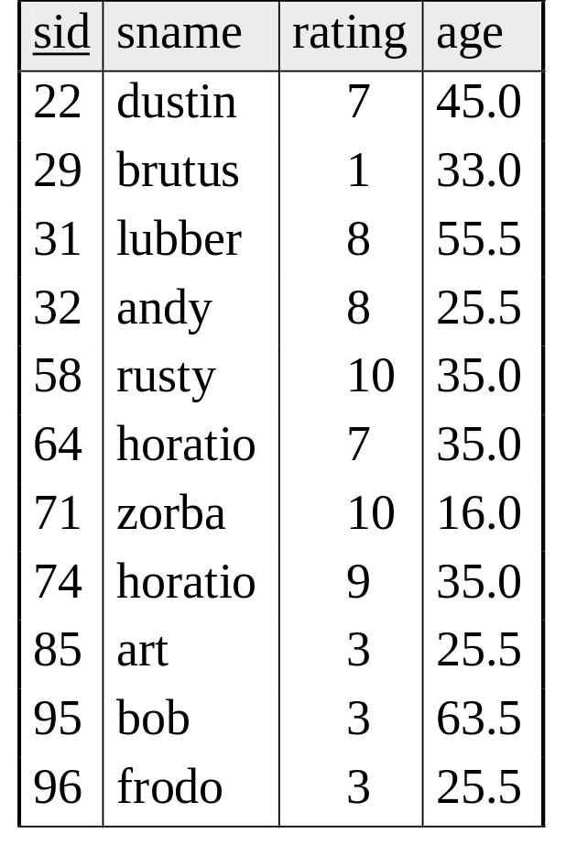
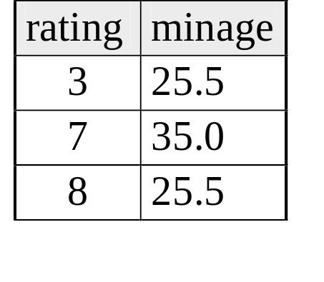
Find age of the youngest sailor with age>= 18, for each rating with at least 2 such sailors
Sailors instance:
SELECT S.rating, MIN (S.age)
AS minage
FROM Sailors S
WHERE S.age >= 18
GROUP BY S.rating
HAVING COUNT (*) > 1
Answer relation:

Slide 32

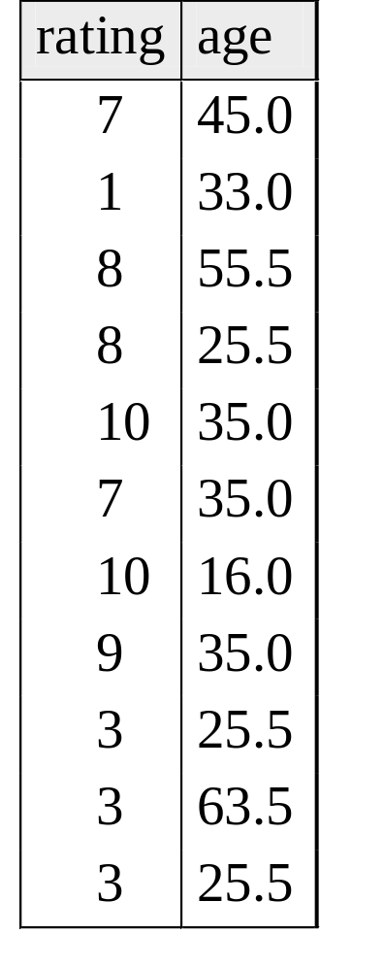
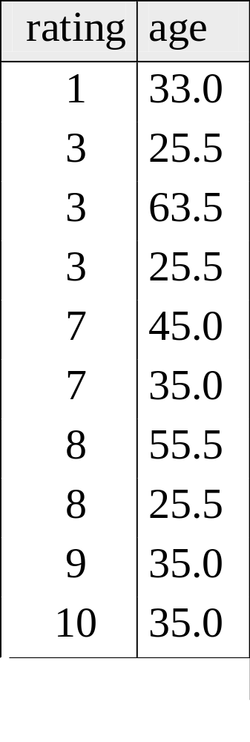
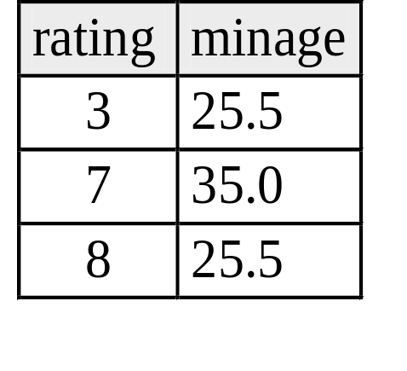
Find age of the youngest sailor with age 18, for each rating with at least 2 such sailors.

Slide 33
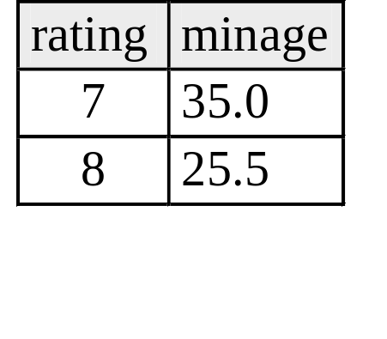
Find age of the youngest sailor with age 18, for each rating with at least 2 such sailors and with every sailor under 60.
HAVING COUNT (*) > 1 AND EVERY (S.age <=60)
What is the result of
changing EVERY to
ANY?

Slide 34
For each red boat, find the number of reservations for this boat
SELECT B.bid, COUNT (*) AS scount
FROM Sailors S, Boats B, Reserves R
WHERE S.sid=R.sid AND R.bid=B.bid AND B.color=‘red’
GROUP BY B.bid
Grouping over a join of three relations.
What do we get if we remove B.color=‘red’ from the WHERE clause and add a HAVING clause with this condition?
What if we drop Sailors and the condition involving S.sid?

Slide 35
Find age of the youngest sailor with age > 18, for each rating with at least 2 sailors (of any age)
SELECT S.rating, MIN (S.age)
FROM Sailors S
WHERE S.age > 18
GROUP BY S.rating
HAVING 1 < (SELECT COUNT (*)
FROM Sailors S2
WHERE S.rating=S2.rating)
Shows HAVING clause can also contain a subquery.

